Slide 1
damming the nile

Slide 2
A new dam on the Nile could trigger a war over water - unless Ethiopia can agree a deal with Egypt and Sudan.

Slide 3
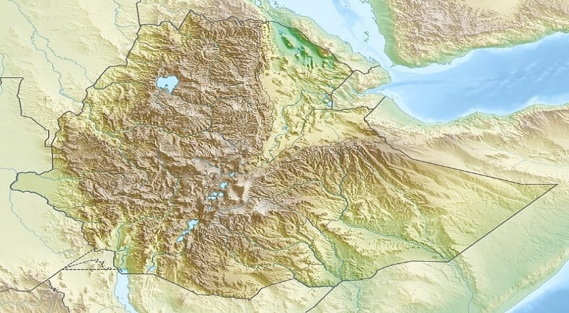
Location

Slide 4
Join the BBC's Africa correspondent Alastair Leithead and his team, travelling from the Blue Nile's source to the sea - through Ethiopia and Sudan into Egypt.
Flying high above the river and its waterfalls, you will inspect the dam up close and take a sunrise balloon ride over Luxor as the story unfolds.
This 360° video is a version of the first VR documentary series from BBC News.
360 video is a new format for BBC News and is currently unsupported in some browsers and operating systems including, Internet Explorer, Safari on a Mac, Android 4 and below, iOS 10.3 and below.
To view the full films, go to bbc.co.uk/virtualreality for more information.

