Slide 1
South wales earthquake

Slide 2
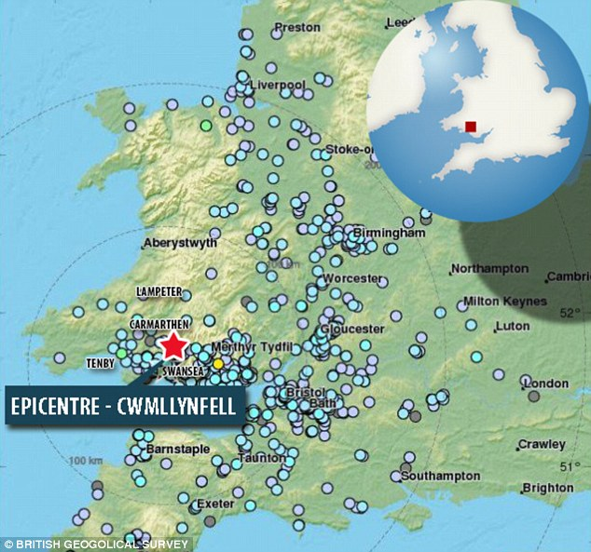
Introduction
TASK: What do you already know about earthquakes?

Slide 3
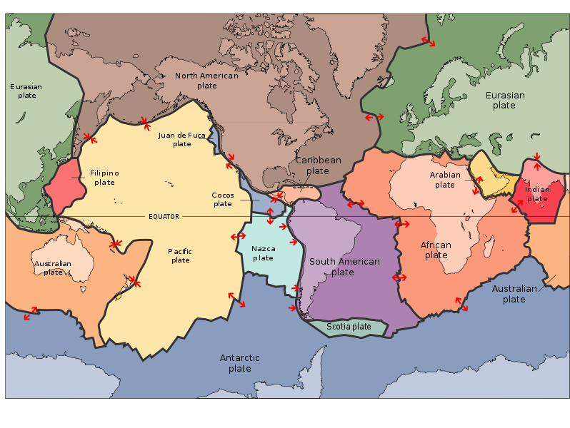
Why are there few earthquakes in Wales?
TASK:Using the map locate Wales and suggest a reason why the country receives less siesmic action

Slide 4
Why are there volcanoes in Indonesia?
The Australian plate (often referred to as Indo- Australian plate) is subducted beneath the Eurasian plate. This occurs on the southern edge of Java, Sumatra and many other Indonesian Islands.

Slide 5
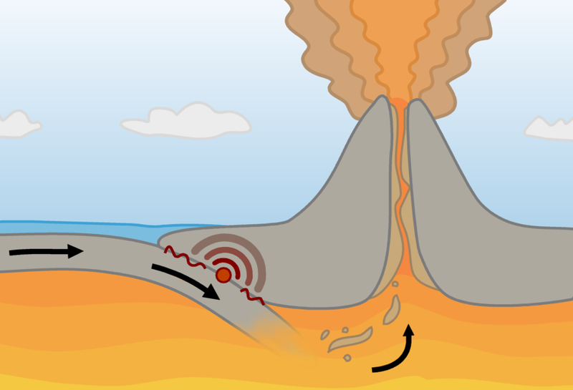
Background Information
TASK: What other types of plate boundary are there?
Mt Merapi
Eurasian plate
Indo- Australian plate
The subduction of the Indo- Australian plate leads to the formation of volcanoes such as Mt Merapi. They are fuelled by the melting of the plate in the mantle.

Slide 6
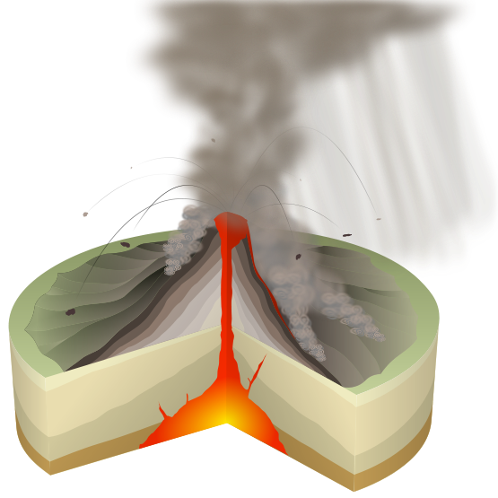
Volcanoes
Layers of lava and ash build up from historical eruptions.
Lava flows. Lava can be runny and fast flowing or thick and slow flowing.
Pyroclastic flows are fast flowing trails of hot rock and steam. They can travel up to 200 kilometres/ hour.
Lava bombs are flung from the volcano during an eruption.
Cloud of ash, steam, dust and gas. This can rain down on the surrounding area.
This is the magma chamber. This is where hot molten rock is stored beneath the Earth.
This is the main vent. This is main route for magma to the surface.
Click for next step

Slide 7
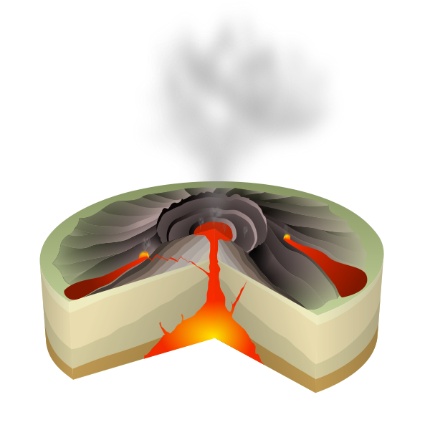
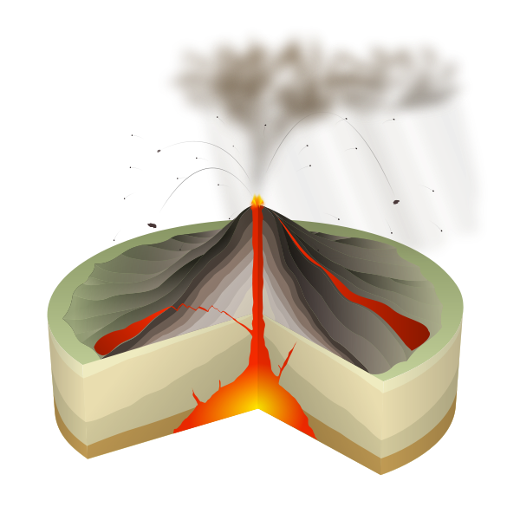
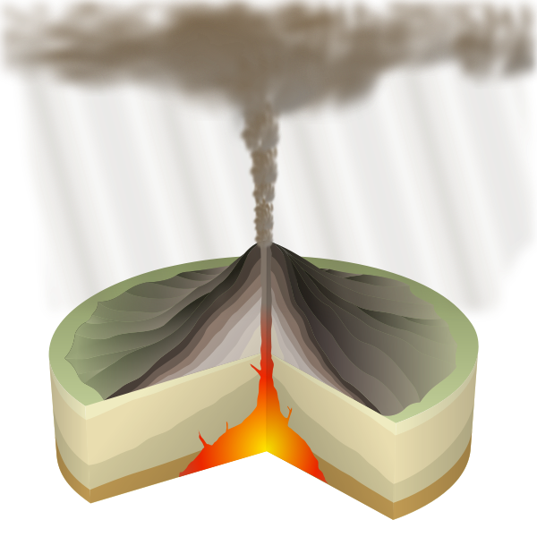
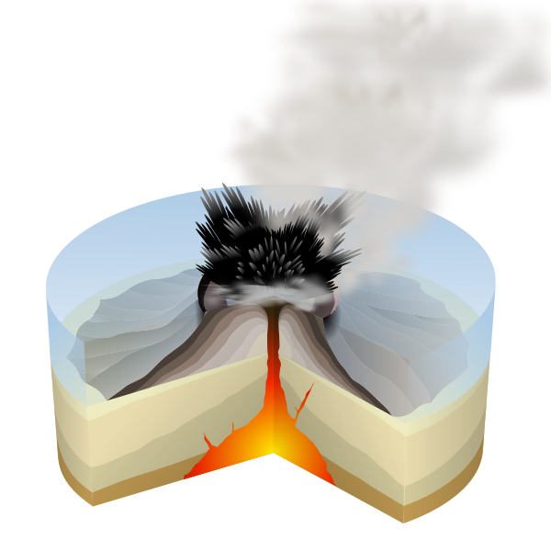
Types of volcanoes
This is a lava volcano. The lava is thick and slow flowing here. This type of lava can be explosive.
This is a lava volcano, but with fast flowing lava. The volcano has much shallower sides as a result.
This is an ash volcano. Ash volcanoes generally have a distinctive crater and steep sides.
Volcanoes can also occur under the sea where cooling occurs much more quickly.

Slide 8
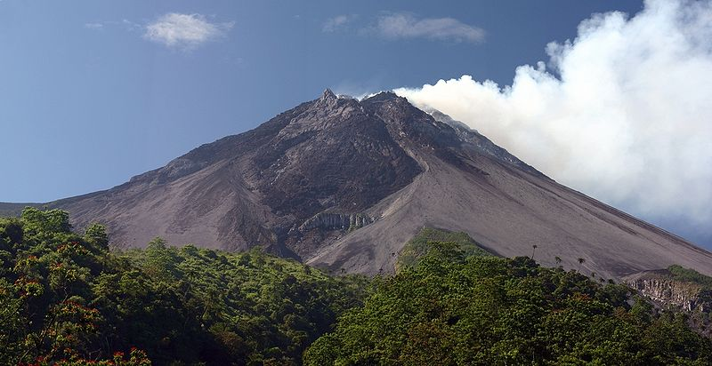
Mt Merapi
Mt Merapi is a stratovolcano located on the island of Java in Indonesia. It has erupted frequently since the 16th century and is the most active volcano in Indonesia.
TASK: Describe its appearance?

Slide 9
Events of 2010
Early October 2010: Increased seismicity, lava dome inflation and lava flows are observed.
Late October 2010: Lava and ash eruptions occur, affecting towns nearby. Ash fall is particularly destructive with residents fleeing the area.
Early November 2010: Huge clouds of ash and gas are thrown 5000m into the air, causing evacuation to at least 15km from the volcano.
Summary: At least 122 people are reported to have died, with tens of thousands affected. Air travel is left in chaos due to ash cloud.
TASK: How do you think volcanoes are monitored?

Slide 10
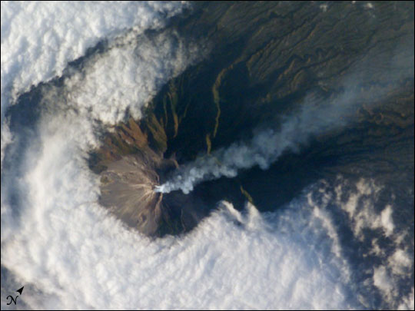
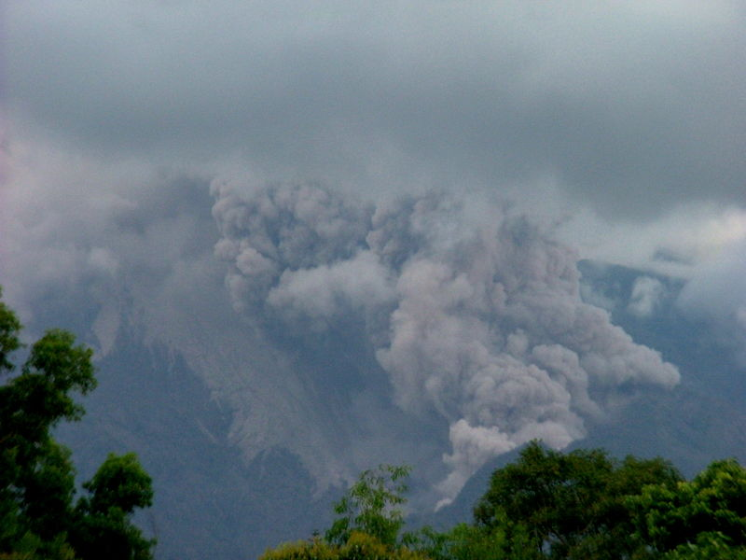
Mt Merapi images
Pyroclastic flows on Mt Merapi
Mt Merapi from above (NASA)
TASK: Describe the photographs. Why are pyroclastic flows so dangerous?

Slide 11
Think about the following questions concerning the events in Indonesia:
Why did pyroclastic flows cause more deaths than lava flows?
Why doesn’t the UK have active volcanoes?
What type of aid will countries send to Indonesia?
What are the signs that an eruption could be about to happen?
Why is air travel affected by Mt Merapi?
Why is ash so dangerous?
Why do people live so close to active volcanoes?

